Slide 1
Big Data Analytics Project
PROFESSOR : Mr. Shabbir Mukhi
Team: Aquib Raza Raja & Hasan Isar Rizvi

Slide 2
B2B Ecommerce Startup
The concerned startup provides a Business-to-Business (B2B) e-commerce platform, designed to revolutionize the way small, medium and large businesses operate across Pakistan through technological advancement and development. We are enabling retailers and businesses to source merchandise from manufacturers, brands, wholesalers etc. on a single platform.

Slide 3
Infrastructure
Our data is stored on AWS S3 Buckets
To create our Hadoop like Cluster we use AWS Redshift a data warehouse hosted on virtualized EC2 instances, to run our cluster.
We setup the required IAM permissions to allow Redshift to access S3 buckets.
Subsequently we use SQL Scripts & AWS Glue to import data to the clusters, database.
Once in the cluster we set the elastic IP and the required permission to access the data for our processing & analytics.

Slide 4
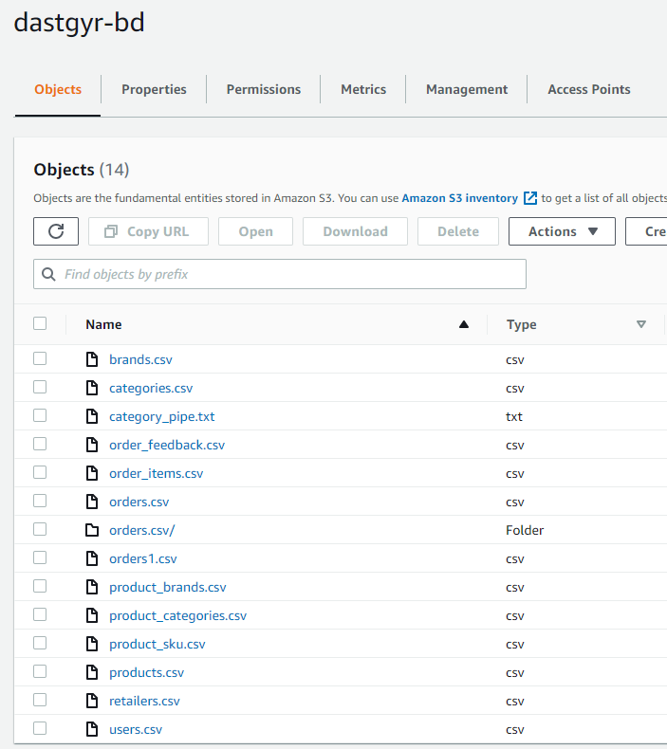
Data Storage
We dumped our data into AWS S3 Buckets in csv format. Our data is in structured format, consisting of raw data exported from table in Dastgyr’s database.

Slide 5
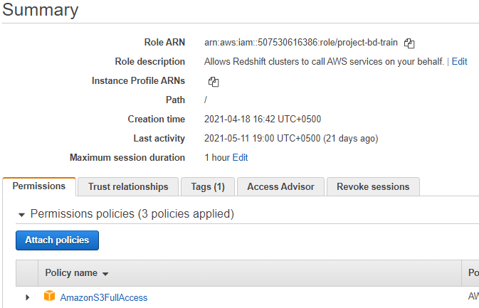
IAM Permissions
A Role is created which will hold the required permissions for our cluster – s3 access.

Slide 6
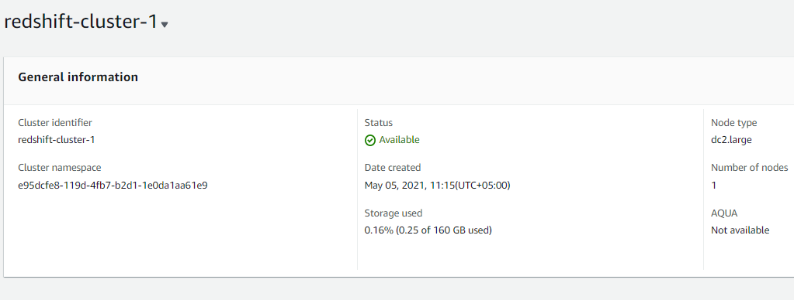
Redshift
We use AWS Redshift, a data warehouse consisting of nodes, which forms a cluster.
Using standard SQL queries we can combine & process our data.

Slide 7
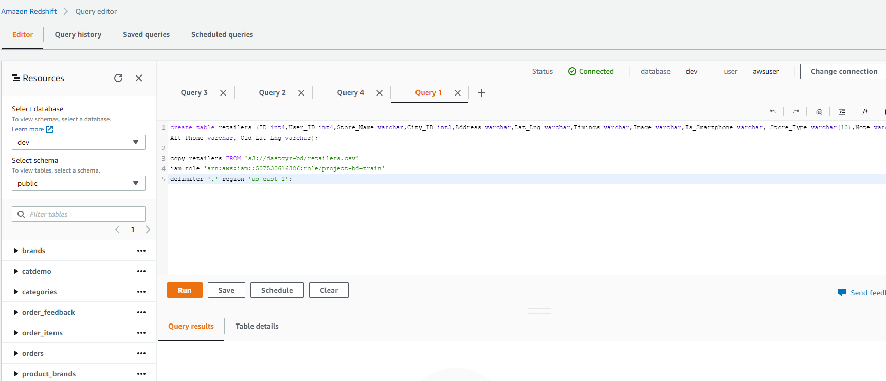
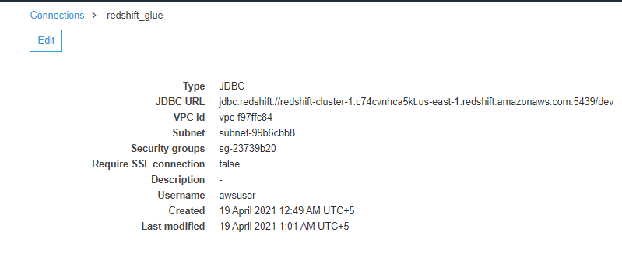
Data Import
Alternate - AWS Glue
Script

Slide 8
Analytics
Connected our AWS Redshift cluster with Python using the redshift_connector library.
The two most important tables we used were “Orders” and “Order Items” which had all the relevant information we needed to do our forecasting using Time Series Analysis on 4 dimensions:
Total Sales: total sales revenue daily
Number of Orders: number of orders placed on the app daily
Number of Active Users: number of unique users who place an order daily
Number of Active SKUs: number of unique SKUs ordered daily

Slide 9
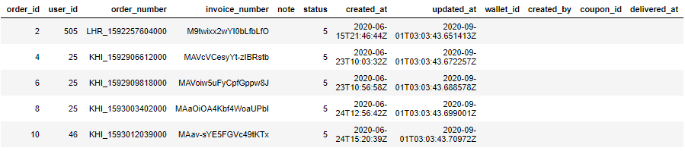
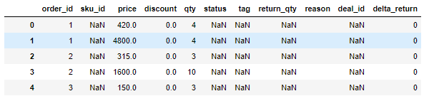
Overview of the Datasets
Orders:
Order Items:

Slide 10
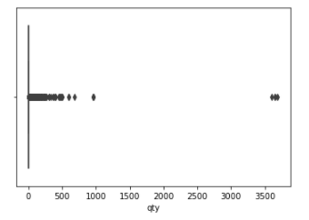
Data Wrangling
Converting format of the date column from timestamp to date
Checking of missing values, but since the columns we required did not have any such missing values so there was not much to be done
Getting rid of outliers

Slide 11
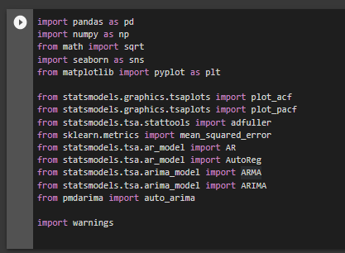
Libraries

Slide 12
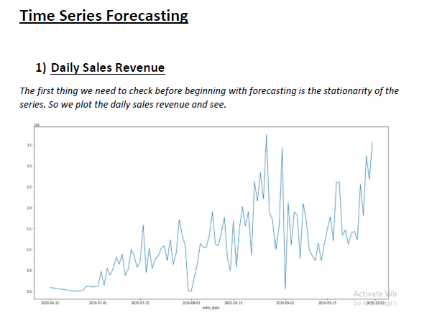
Time Series Forecasting
Daily Sales Revenue
The first thing we need to check before beginning with forecasting is the stationarity of the series. So we plot the daily sales revenue and see.

Slide 13
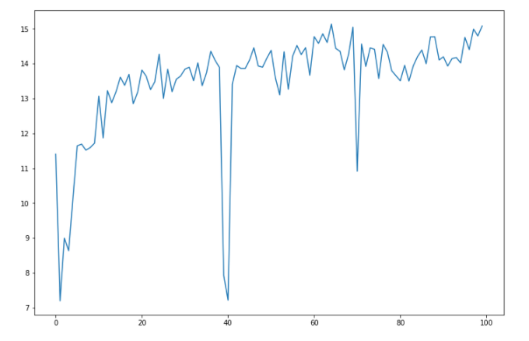
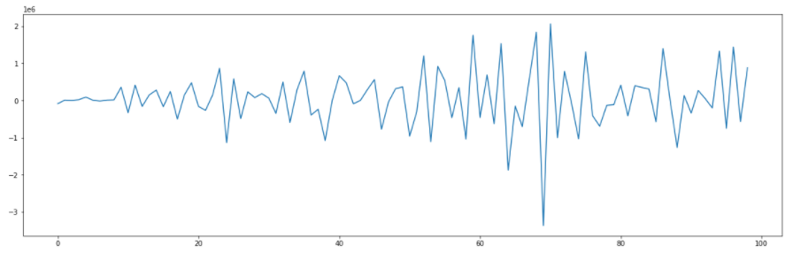
Augmented Dickey Fuller (ADF) Test for Stationarity
Power Log Transforms
Differencing

Slide 14
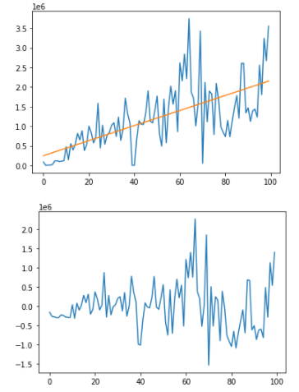
De-trending by Model Fitting

Slide 15
Forecasting
AR (Autoregression) Model
ARMA (Auto Regression Moving Average) Model
ARIMA (Auto Regression Integrated Moving Average) Model

Slide 16
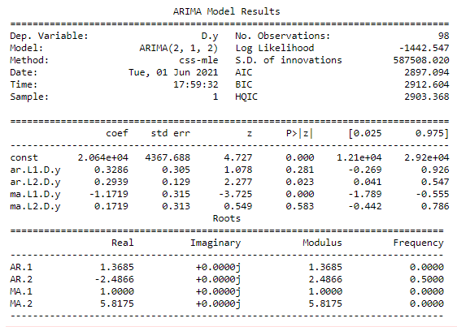
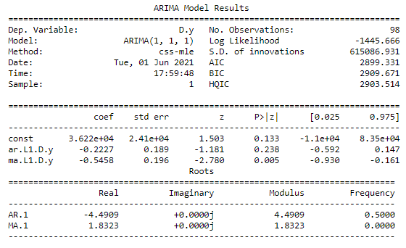
Application of ARIMA Model on the Daily Sales series
We can see that the ARIMA model with parameters p=2, d=1, q=2 has a lower AIC score so we will use that to forecast our daily sales

Slide 17
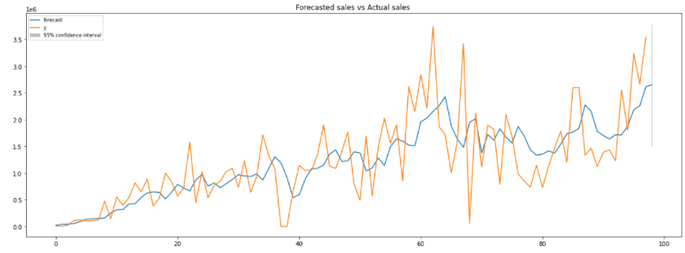
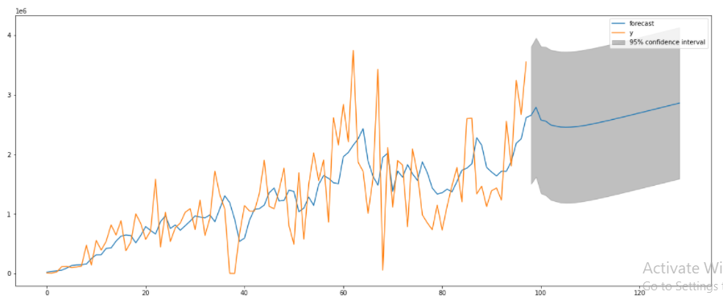
Applying the ARIMA model
Forecasted vs Actual Sales:
Forecasting for next 30 days:

Slide 18
Forecasting the Daily Orders Series

Slide 19
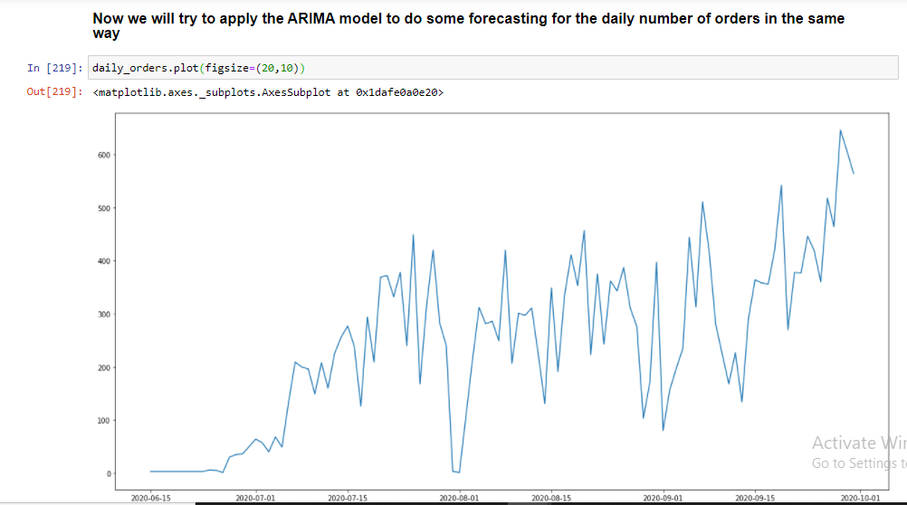
Daily Orders
The shape of the series can be seen above.

Slide 20
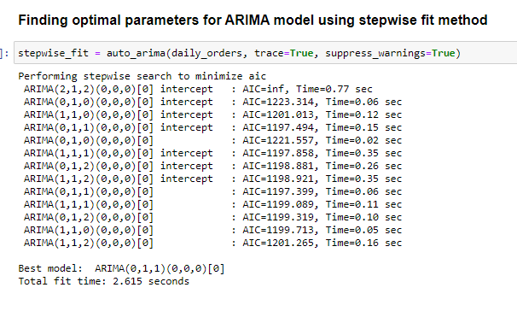

Slide 21
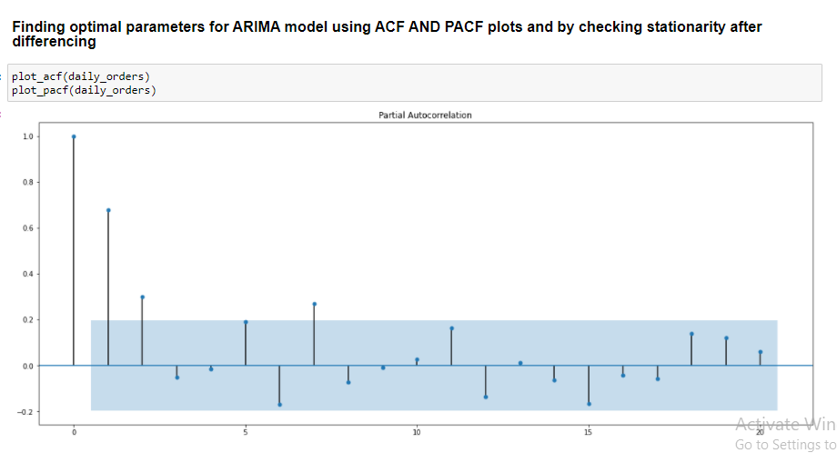

Slide 22
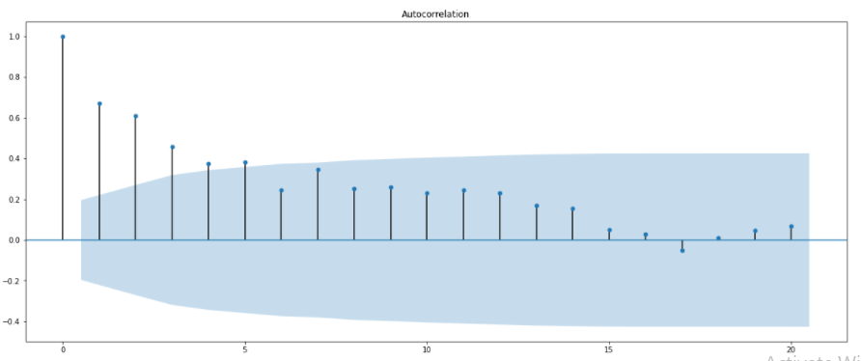
Looking at the Autocorrelation and Partial Autocorrelation plots to decide the parameters p and q.
We can set the parameters to p = 2 and q = 3.

Slide 23
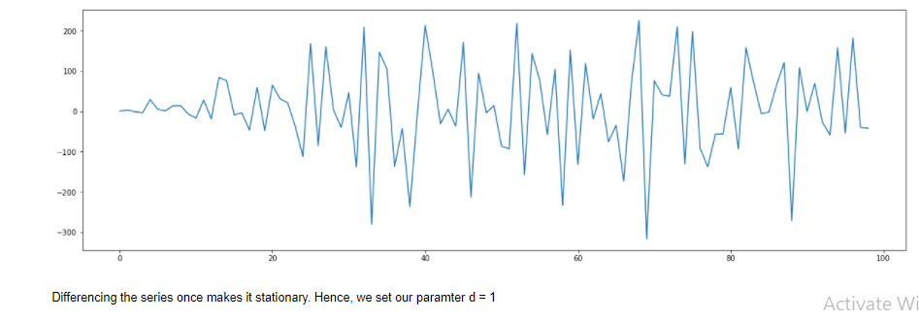
Differencing

Slide 24
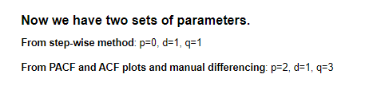

Slide 25
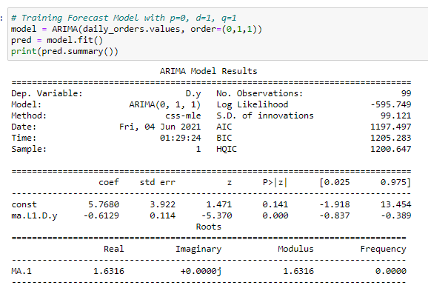
Results of ARIMA(0,1,1) model

Slide 26
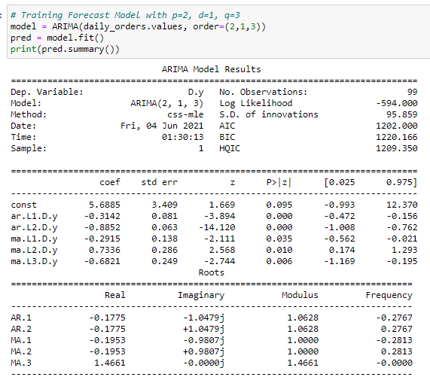
Results of ARIMA(2,1,3) model

Slide 27
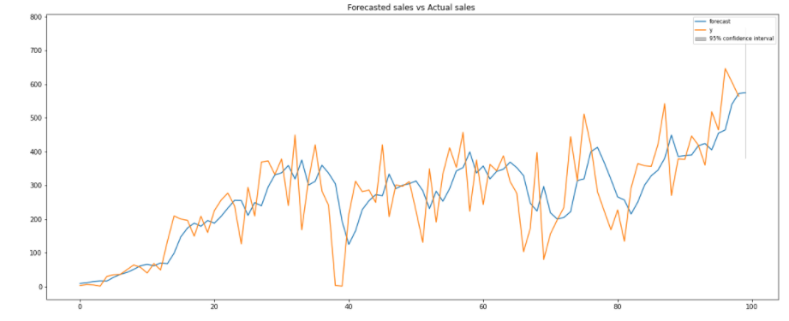
Checking the Forecasted vs Actual sales for the series using the ARIMA(0,1,1) model

Slide 28
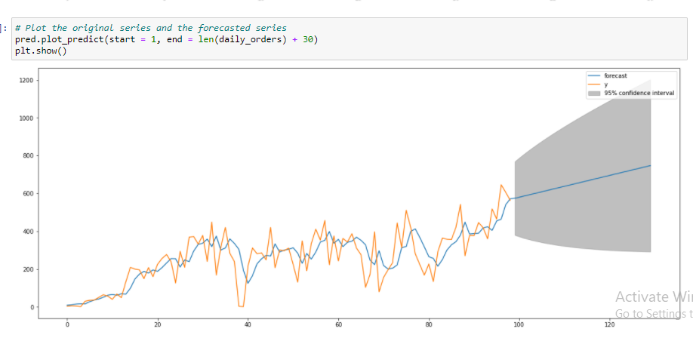
Forecasting daily orders for the next 30 days using the ARIMA(0,1,1) model

Slide 29
Forecasting the Daily Active Users Series

Slide 30
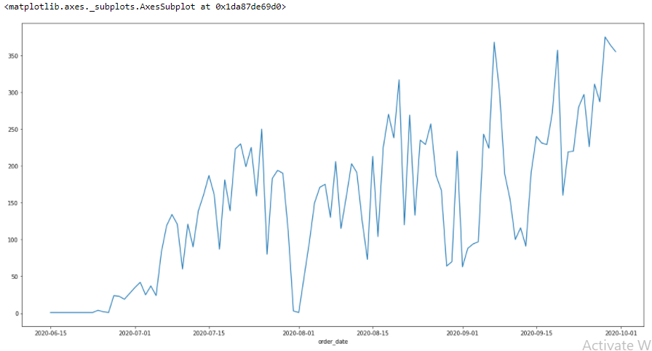
Daily Active Users
The shape of the series can be seen above.

Slide 31
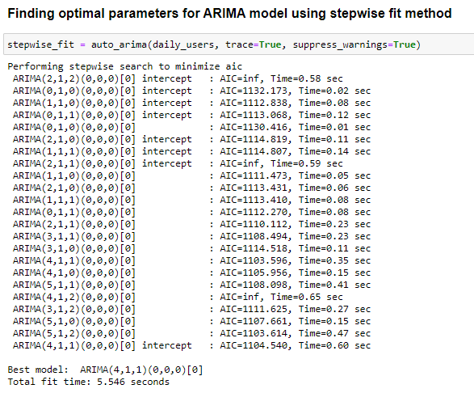

Slide 32
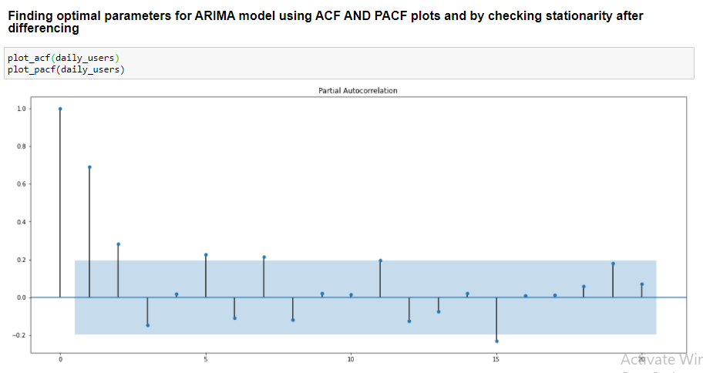

Slide 33
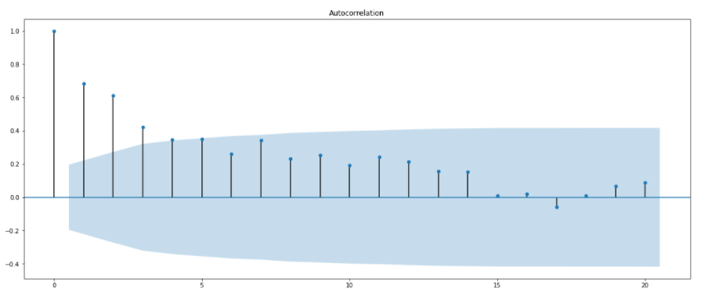
Looking at the Autocorrelation and Partial Autocorrelation plots to decide the parameters p and q.
We can set the parameters to p = 2 and q = 3.

Slide 34
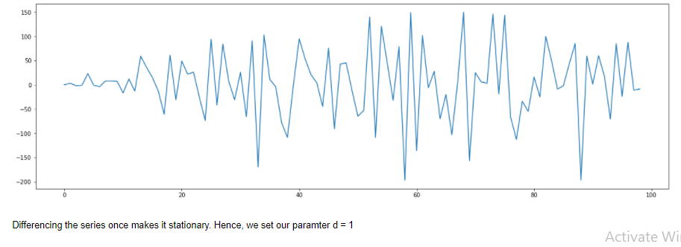
Differencing

Slide 35
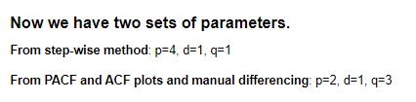

Slide 36
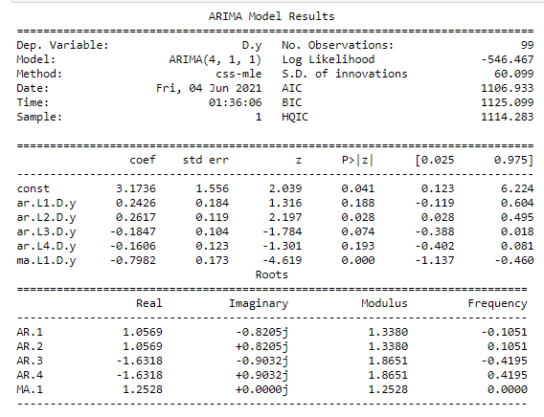
Results of ARIMA(4,1,1) model

Slide 37
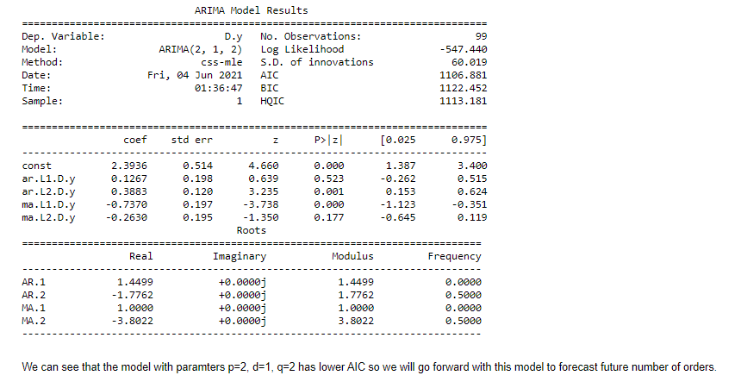
Results of ARIMA(2,1,3) model

Slide 38
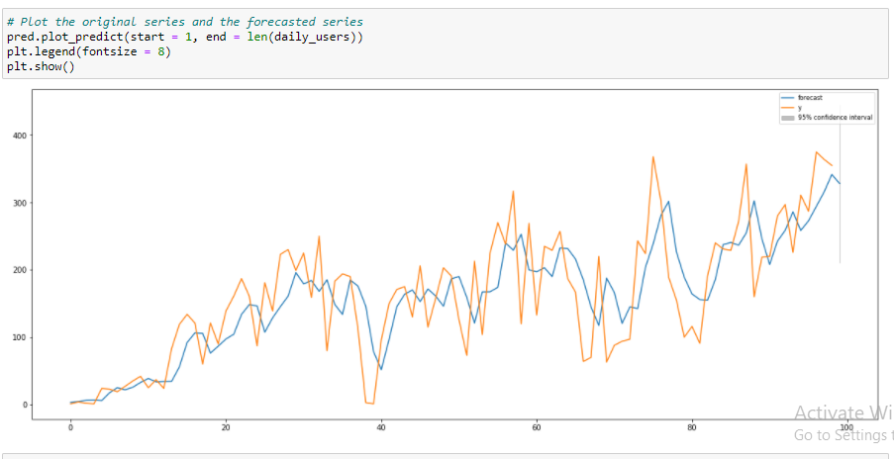
Checking the Forecasted vs Actual sales for the series using the ARIMA(0,1,1) model

Slide 39
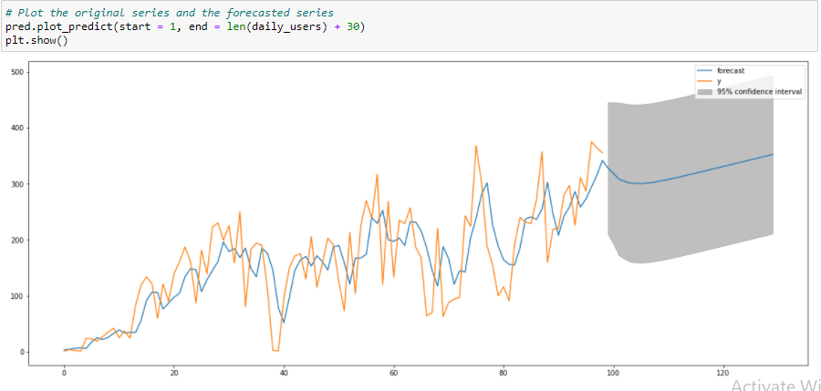
Forecasting daily orders for the next 30 days using the ARIMA(0,1,1) model

Slide 40
Forecasting the Daily Active SKUs Series

Slide 41
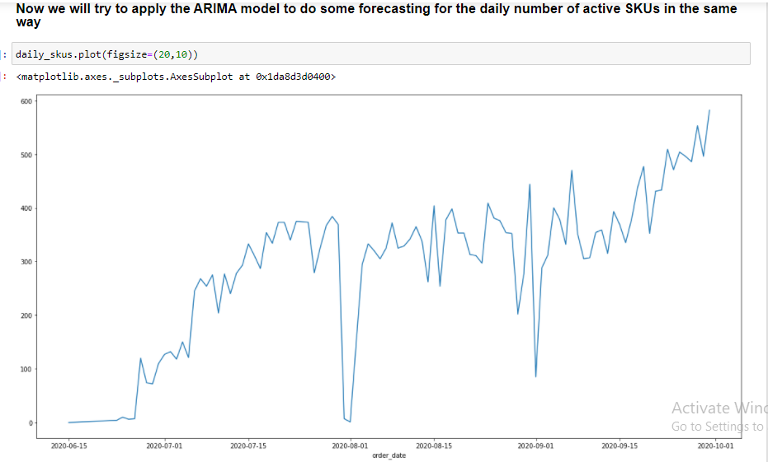
Daily Active SKUs
The shape of the series can be seen above.

Slide 42
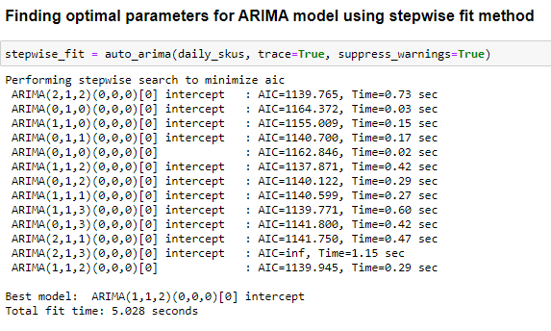

Slide 43
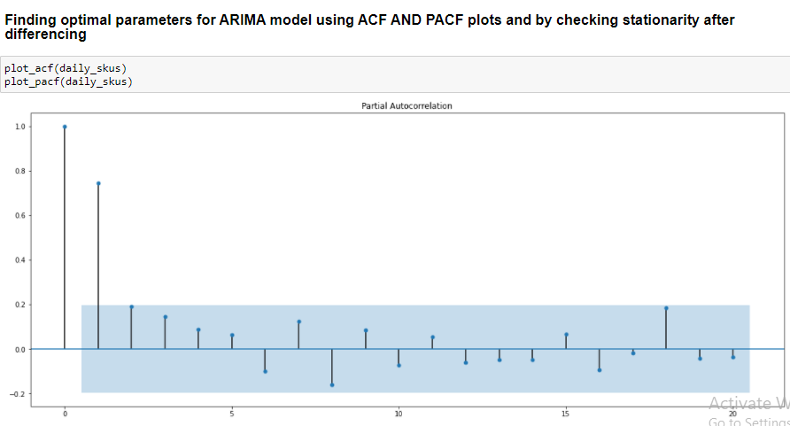

Slide 44
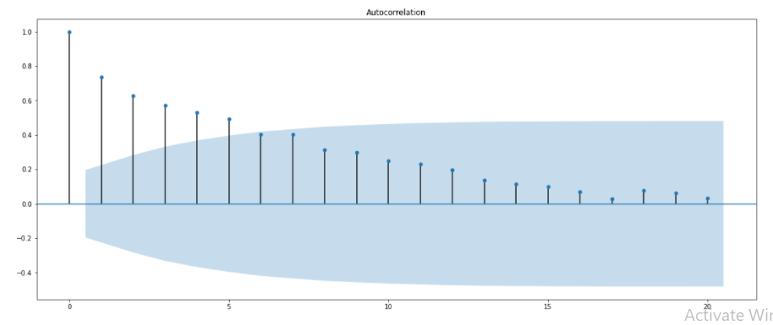
Looking at the Autocorrelation and Partial Autocorrelation plots to decide the parameters p and q.
We can set the parameters to p = 1and q = 3.

Slide 45
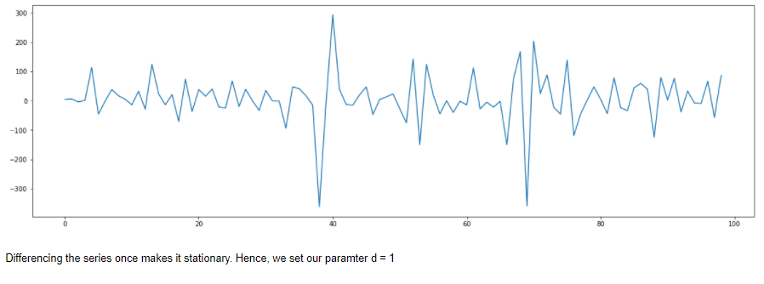
Differencing

Slide 46
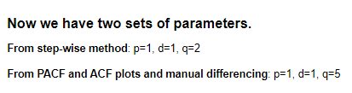

Slide 47
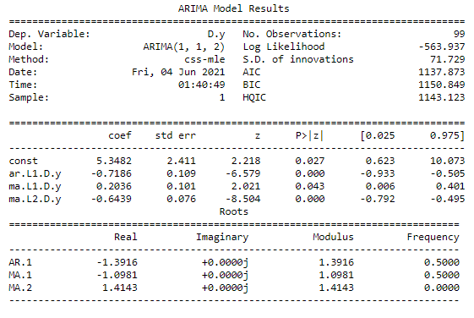
Results of ARIMA(1,1,2) model

Slide 48
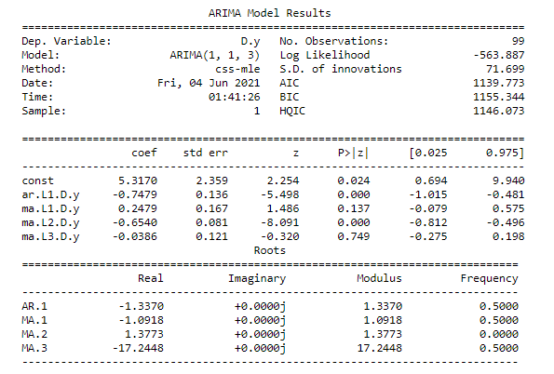
Results of ARIMA(1,1,3) model

Slide 49
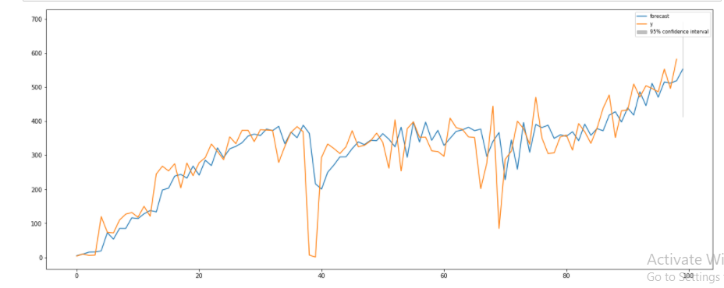
Checking the Forecasted vs Actual sales for the series using the ARIMA(0,1,1) model

Slide 50
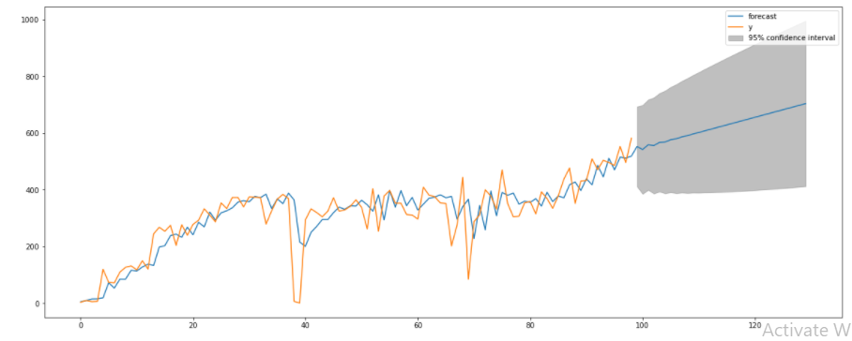
Forecasting daily orders for the next 30 days using the ARIMA(0,1,1) model

Slide 51
THANK YOU

